Slide 1
Side-Channel Vulnerabilities
Programming at the Hardware/Software Interface

Slide 2
This work is licensed under a Creative Commons Attribution 4.0 International License. This work is ©2018-21 Christopher A. Bohn, bohn@unl.edu.
You are free to:
Share — copy and redistribute the material in any medium or format
Adapt — remix, transform, and build upon the material for any purpose, even commercially
Under the following terms:
Attribution — You must give appropriate credit, provide a link to the license, and indicate if changes were made. You may do so in any reasonable manner, but not in any way that suggests the licensor endorses you or your use.
No additional restrictions — You may not apply legal terms or technological measures that legally restrict others from doing anything the license permits.
Slide by Bohn
These lecture slides are meant to enhance your use of the Programming at the Hardware/Software Interface textbook. If you have not adopted this publication for your course, please consider doing so.

Slide 3
Meltdown & Spectre
images by meltdownattack.com

Slide 4
Opening Caveats
Proof of concept code exists
No known in-the-wild cases
Nothing you as a HLL programmer can do
Operating systems & compilers (now) provide protection
Slide by Bohn

Slide 5
Exploiting Out-of-Order Engine
# some kernel address in %rcx
# “array” base address in %rbx
xorq %rax, %rax
loop:
movb (%rcx), %al
shlq 0xC, %rax
jz loop
movq (%rbx, %rax), %rbx
Repeat for several kernel addresses
Clears %rax
Places one byte in %rax
User code cannot access this memory, raises exception
Multiplies value by 4096
If CPU stalls on load, try again
Read from “array”
Slide by Bohn
Notes:
Recall that the out-of-order engine allows the processor to execute instructions at any time once their dependences have been resolved. Instructions can even be speculatively executed: once it’s determined whether an instruction should have executed, it is either retired (its functional effects made permanent) or flushed.
Here, we’re pretending to have a very large array. We’re going to use a value from kernel-space memory (multiplied by 4096) to index the array.

Slide 6
C code
char *secret_data;
secret_data = …;
long *probe = (long *)malloc(256*4096);
long index = 0;
do {
index = *secret_data << 12;
} while (!index);
probe += index;
// probe = (long *)probe[index];
…
void exception_handler (int signal) {
;
}
# some kernel address in %rcx
# “array” base address in %rbx
xorq %rax, %rax
loop:
movb (%rcx), %al
shlq 0xC, %rax
jz loop
movq (%rbx, %rax), %rbx
Repeat for several kernel addresses
Slide by Bohn
Notes:
Here is the rough C-equivalent.
Because the memory we access (secret_data / %rcx) isn’t part of our process, we should get a fault to prevent us from accessing it. So we write an exception handler that lets our program continue executing, but the functional result is that *secret_data was never updated, and so index=0, and so we try again. If, however, we are able to read a value, then we index the array using the index.
But we shouldn’t ever be able to read a value, right? Right?

Slide 7
Micro-ops
# some kernel address in %rcx
# “array” base address in %rbx
xorq %rax, %rax
loop:
movb (%rcx), %al
shlq 0xC, %rax
jz loop
movq (%rbx, %rax), %rbx
Repeat for several kernel addresses
loop:
permission-check (%rcx), %rww
beq %rww, %r0, no_permission
ldb (%rcx), %rxx #update rax on retire
shl 0xC, %rxx, %ryy #update rax on retire
beq %ryy, %r0, loop
add %rbx, %ryy, %rzz
ldq (%rzz), %rvv #update rbx on retire
…
no_permission:
call general_protection_fault
Slide by Bohn
Notes:
Let’s decompose the x86 assembly code into RISC-like instructions. (These are not the actual micro-op instructions; these are merely notional micro-op instructions to convey what’s happening; similarly, the renamed registers are notional logical registers.) We’ve now broken down the tasks with distinct do-one-thing micro-ops that the OoO engine can issue.

Slide 8
Out-of-Order Execution + Speculative Execution
Takes long time, starts early
Does not need to execute until other instructions retire
ldb (%rcx), %rxx
permission-check (%rcx), %rxx
shl 0xC, %rxx, %ryy
add %rbx, %ryy, %rzz
Slide by Bohn
call general_protection_fault
ldq (%rzz), %rvv
Race
Do not need to retire as long as reservation station has room
Notes:
Knowing that retrieving a value from memory can take a (relatively) long time, we can imagine that the OoO engine will issue this instruction early and hold off on retiring/flushing this instruction and those that depend on it until after the permission check comes back (which might get issued later).
This introduces a race condition: will we index the “array” before the protection fault is generated?

Slide 9
So What?
Takes byte from kernel space, multiplies the value by 4K
Indexes array with 4KB stride
x86 memory pages are 4KB
Read from only one possible page, for given byte value
Slide by Bohn
Notes:
This is why we’re pretending to have such a huge array

Slide 10
Again: So What? All of the operations got flushed
#include <sys/time.h>
…
long x;
int stride = 4096/8;
struct timeval *t1, *t2;
struct timeval duration[256];
for (index=1; i<256; i++) {
get_itimer(ITIMER_REAL, t1);
x = probe[index*stride];
get_itimer(ITIMER_REAL, t2);
timeval_subtract( duration+index, t1, t2)
}
The attack code read one of 255 possible pages
Value read was flushed by OoO engine
Memory hierarchy still affected
When we access all 256pages, 255 will have TLB misses, 1 will have hit
If probe[x*stride] had fastest access, then secret_data = x
Slide by Bohn
Notes:
Even though the instructions weren’t retired, and there was no permanent functional effect on our program, there was an effect on the computer system: one page of virtual memory was accessed. The translation lookaside buffer (the cache for the page table) has an entry for that page.
Now access each of the possible array indexes, and times how long it takes to access each of them.
The page we already accessed is probably the only one that’s also in physical memory, but even if it gets displaced by the timing code, it will still load faster because of the existing TLB entry.
Once we know which index we were able to access faster than the others, we know which index we’d already attempted to access, and thus we know the secret value.

Slide 11
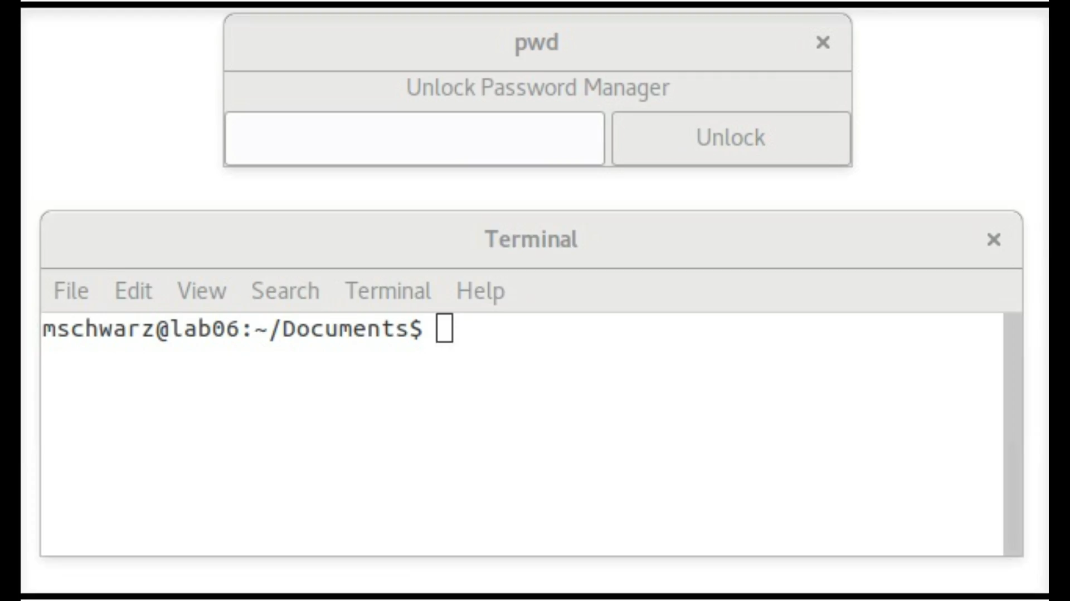
Example
%rcx
P
a
s
s
w
o
r
d
Run attack
probe[80*stride] has fastest access
secret_data = ‘P’
Flush/Reload TLB, increment %rcx, run attack
probe[97*stride] has fastest access
secret_data = ‘a’
Flush/Reload TLB, increment %rcx, run attack
probe[115*stride] has fastest access
secret_data = ‘s’
Slide by Bohn
video by meltdownattack.com

Slide 12
Exploiting Branch Prediction
if (x<256) {
secret = array1[x];
y = array2[secret];
}
Run many times with x<256
Train branch predictor to expect x<256
Flush cache
Run with x≥256
Slide by Bohn
Notes:
As with Meltdown, Spectre is going to access an array in such a manner that we’ll later be able to use timing information to find out what the secret value was.
Where Meltdown used the existence of a TLB entry, Spectre uses the existence of an entry in memory cache.
Rather than exploiting the OoO engine, Spectre exploits the branch predictor. Recall that modern processors’ branch predictors use the history of whether a particular branch was taken or not, to predict whether it should be taken. So our attack uses this simple loop. We’ll train the branch predictor to predict that the “if” block is always the path to take. Then we’ll give it a value that should result in the “if” block not being taken.
We’ll choose a value for x that isn’t just at least 256, but it’s much, much greater than 256. Specifically, x plus the base address of array1 will equal the base address for the secret array.

Slide 13
Then What?
 | array1 |  | array2 | Cached array2
 | ‘a’ | x+1
 | ‘P’ | x
 |  | x-1
 |  | $$⋮$$
 |  | 256
 |  | 255 | 92 | 0
 |  | $$⋮$$ | $$⋮$$ | $$⋮$$
 |  | 81 | 2019 | 0
 |  | 80 | 58 | 0
 |  | 79 | 100 | 0
 |  | $$⋮$$ | $$⋮$$ | $$⋮$$
 |  | 1 | 150 | 0
 |  | 0 | 1869 | 0
secret=80
Branch predictor guesses that if-block should execute
secret = array1[x];
y = array2[secret];
Cache miss
Retrieve value from main memory
Processor realizes if-block should not have executed
Time access to array2[0]..array2[255]
Cached element’s index is secret value
Slide by Bohn
y=??
58
y=58
Notes:
Because the branch predictor expects the “if” block to be executed, the processor will speculatively execute the “if” block, indexing array1 with the huge x (remember: no bounds checking)
Now we use the value at array1[x] to index another array. Because we previously flushed the cache, it will be a cold miss. Now we start our timing code: we access each of the array2 elements; only one of them will produce a cache hit, and so that index is the secret value.

Slide 14

Key Ideas
Slide by Bohn

